Slide 1
Connectome Coding
Joshua Vogelstein
Dept of BME, Johns Hopkins university
w: jovo.me e: jovo@jhu.edu s:brainx.io/sfn17
Please interrupt and ask questions!

Slide 2
what is connectome coding
applications of connectome coding

Slide 3
what is connectome coding?

Slide 4
Neural coding: characterizing the relationship between the ongoing environment and neural activity
Ongoing environment: stimulus, movements, rewards, etc.
Connectome Coding: characterizing the relationship between the past environment and the neural connectivity
Past environment: genome, psychiatric condition, memory, location, etc.

Slide 5
Principles of Data Science
Look at it
Keep it simple
Let’s do it for the neural coding

Slide 6

Look at it

Slide 7
Keep it Simple
Neural Encoding: P[r | s]
Neural Decoding: P[s | r]
Neural Code: P[s,r]

Slide 8
Keep it Simple
We need the joint distribution of brain stuff & external stuff:
Joint distribution: P[s,r] = P[r | s] P[s]
So, we need P[r], P[s], P[r|s]
Let’s start with P[r]

Slide 9
Keep it Simple
Each spike is independent
Probability of a spike at any time is λ
P[r] = Poisson(λ)

Slide 10
Principles of Data Science
Look at it
Keep it simple
Let’s do it for networks, P[g]

Slide 11
Look at it

Slide 12
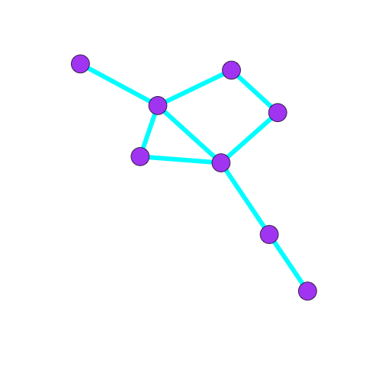
a simple graph
nodes/
vertices/
actors
edges/
arcs
G=(V,E)

Slide 13
the same graph

Slide 14
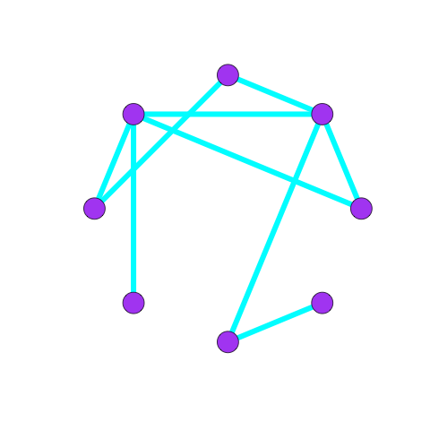
the same graph

Slide 15
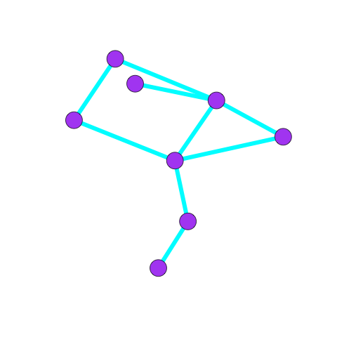
the same graph

Slide 16
the same graph
G=(V,E)
u,v ∈ V
u~v ∈ E

Slide 17
labeled graph
B
uv means there is an edge between u & v
e.g., in this graph AB, but not AE
A
C
E
D

Slide 18
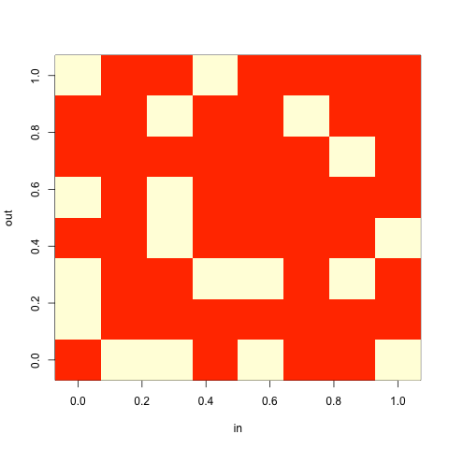
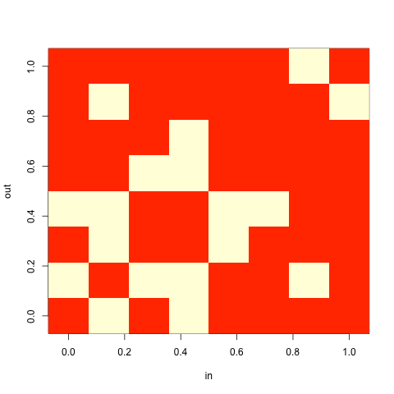
same graph
(2D layout)
same graph
(adjacency matrix)
A is the adjacency matrix
A(u,v) = 1 iff u~v

Slide 19
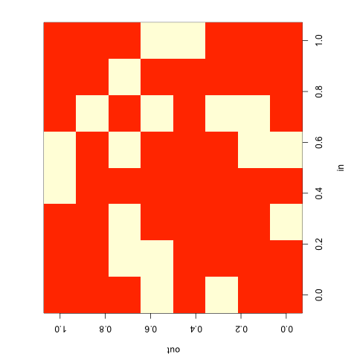
same graph
(2D layout)
same graph
(adjacency matrix)

Slide 20
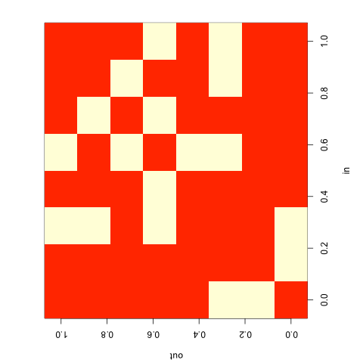
same graph
(2D layout)
same graph
(adjacency matrix)

Slide 21
Look at it
c. elegans: ~10²
larval drosophila: ~10⁴
larval zebrafish, adult drosophila: ~10⁵
DTI-derived human connectome: ~10⁶
adult zebrafish, mouse: ~10⁷
monkey: ~10⁹
human: ~10¹¹

Slide 22
Keep it Simple
Each edge is independent
Probability of a edge between any pair of vertices is p
P[auv] = Bernoulli(p)

Slide 23
Keep it Simple
Neural Encoding: P[r | s]
Neural Decoding: P[s | r]
Neural Code: P[s,r]
Connectome Encoding: P[g | s]
Connectome Decoding: P[s | g]
Connectome Code: P[s,g]

Slide 24
What’s a connectome?

Slide 25
Principles of Data Science
Look at it
Keep it simple
Let’s do it for connectome coding now

Slide 26
connectome = brain-graph
vertices:
brain regions
or voxels
or electrodes
or neurons
or even compartments
edges:
physical connections
or functional connections
or correlations

Slide 27
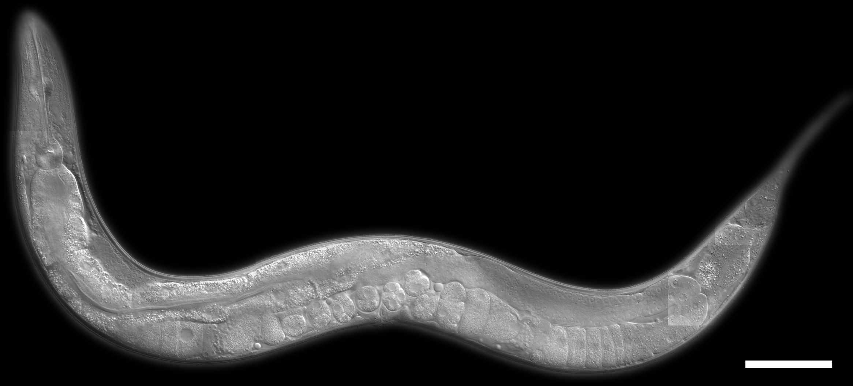
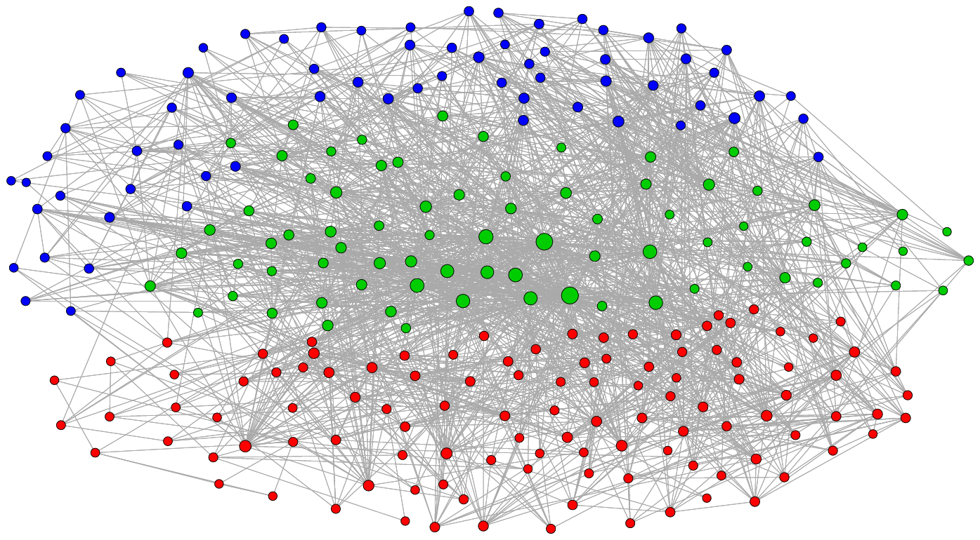
c. elegans

Slide 28
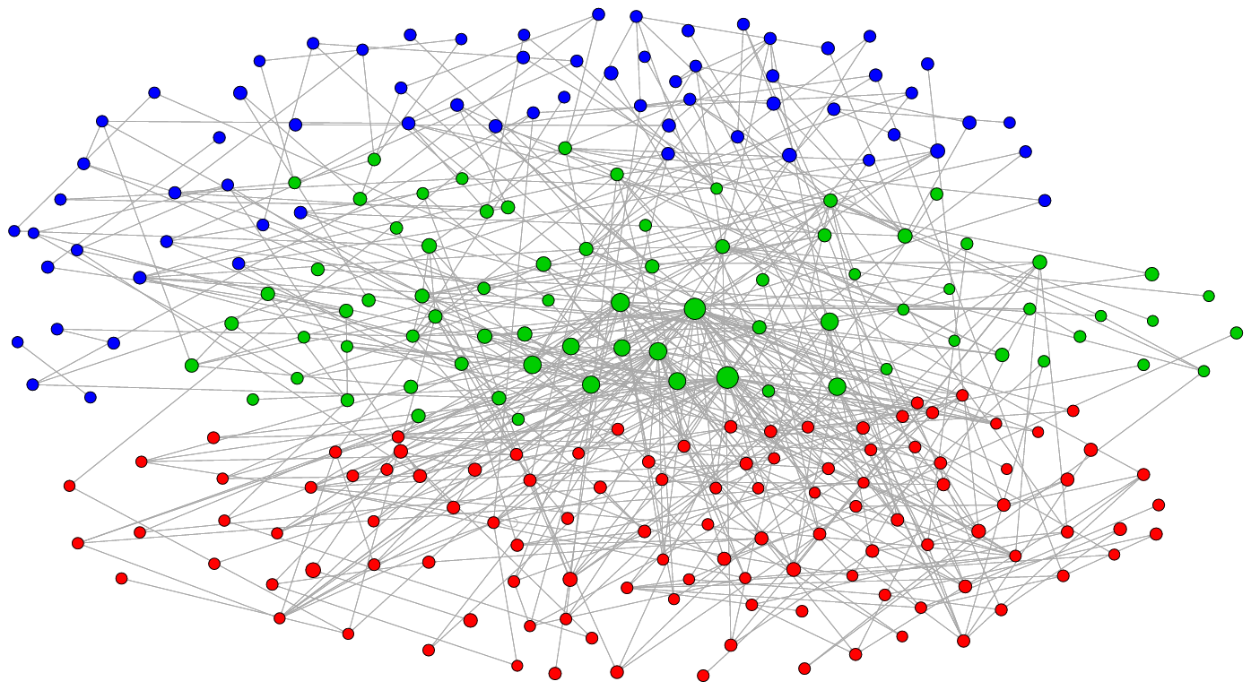
c. elegans

Slide 29
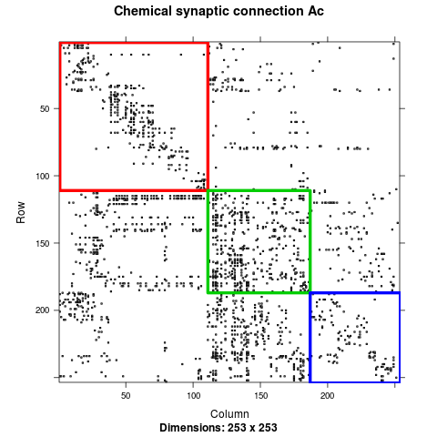
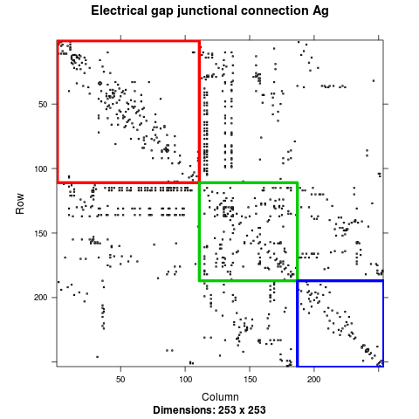
c. elegans

Slide 30
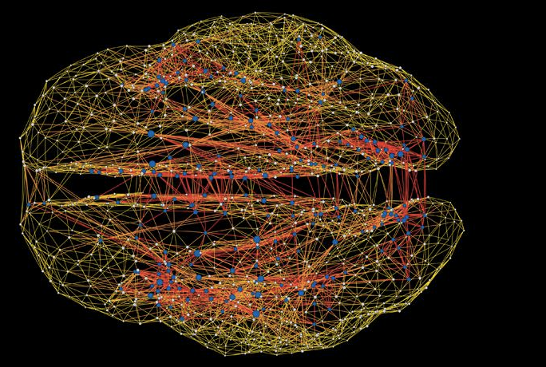
human connectome

Slide 31
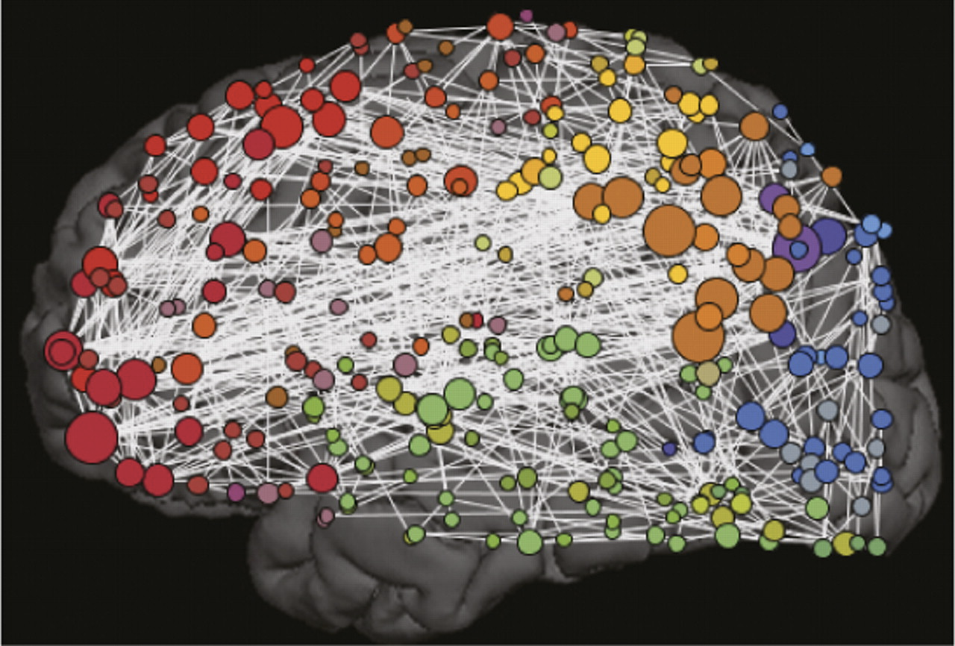
human connectome

Slide 32
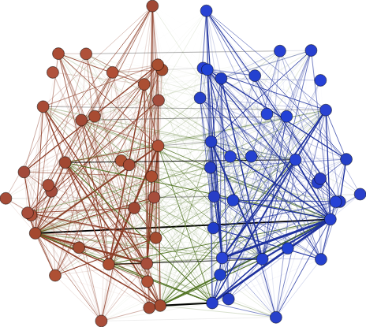
human connectome

Slide 33
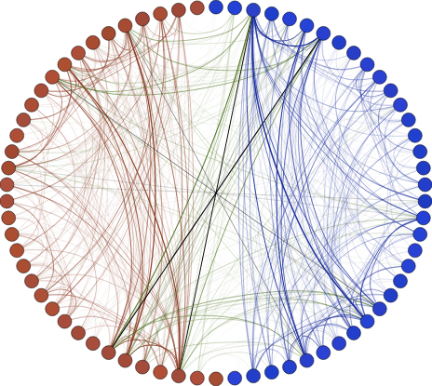
human connectome

Slide 34
Keep it Simple
Each edge is independent
Probability of a edge between any pair of vertices is p
P[auv] = Bernoulli(p)

Slide 35
Principles of Data Science
Look at it
Keep it simple
Let’s do it for the conditional response, P[r|s]

Slide 36


Slide 37
Keep it Simple
Each spike is independent
Probability of a spike at any time is λi
P[r|s] = Poisson(λs)

Slide 38
Principles of Data Science
Look at it
Keep it simple
Let’s do it for the conditional response, P[g|s]

Slide 39
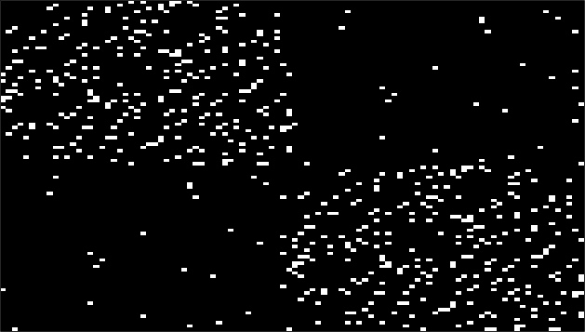
Look at it

Slide 40
Keep it Simple
Each edge is independent
Probability of an edge within a hemisphere is pw
Probability of an edge between hemisphere is pb
B=[pw pb; pb pw]
P[g|s] = SBM( B | τ )

Slide 41
let’s do it for a little bit more complex models

Slide 42
weighted graph
each edge has a weight
weights can be positive, negative, integer, zero, etc.

Slide 43
weighted graph
(2D layout)
weighted graph
(adjacency matrix)
elements of A can take any value

Slide 44
vertex attributed graph
B
A: L
B: R
C: R
D: L
E: L
A
C
E
D
categorical
attributes

Slide 45
vertex attributed graph
B
A: 6
B: 4
C: 0.2
D: 8.7
E:-3.14
A
C
E
D
numerical
attributes

Slide 46
vertex attributed graph
B
A: (6,5,7)
B: (4,0,9)
C: (1,8,6)
D: (5,5,2)
E: (8,3,9)
A
C
E
D
multi-dimensional
attributes

Slide 47
edge attributed graph
B
AB: 6
BC: 4
BE: 0.2
CE: 8.7
CD:-3.14
A
C
E
D
numerical
attributes

Slide 48
graph attributed graphs
subject 1
scan 2

Slide 49
Graphs with Rich attriUTEs (Grutes)
B
A
C
E
D
A: 6, L
B: 4, R
C: 1, L
D: 0, L
E: 8, R
AB: 6
BC: 4
BE: 0.2
CE: 8.7
CD:-3.14

Slide 50
Latent Structure Model
Each vertex can have latent & observed variable
can be categorical, numerical, vectors, etc.
The latent variables have structure
can be cluster, nonlinear relationships, hierarchy, etc.

Slide 51
applications

Slide 52
Human DTI Connectome Code
ipsilateral connections are stronger than contralateral

Slide 53
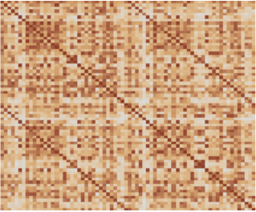
Human fMRI Connectome Code
bilateral connections are stronger than non-bilateral

Slide 54
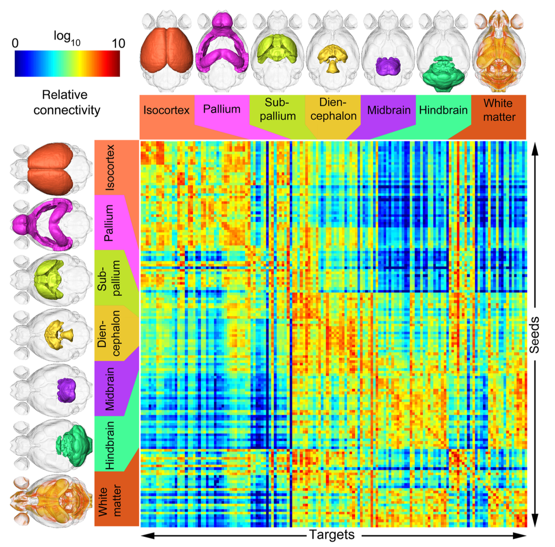
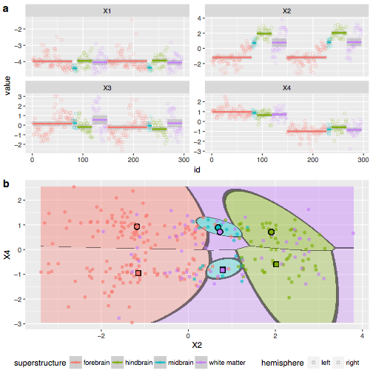
Mouse Connectome Code

Slide 55
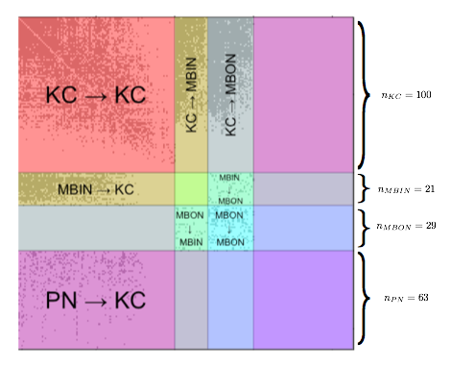
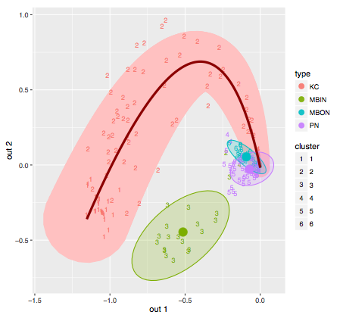
Larval Drosophila Mushroom Body Connectome Code

Slide 56
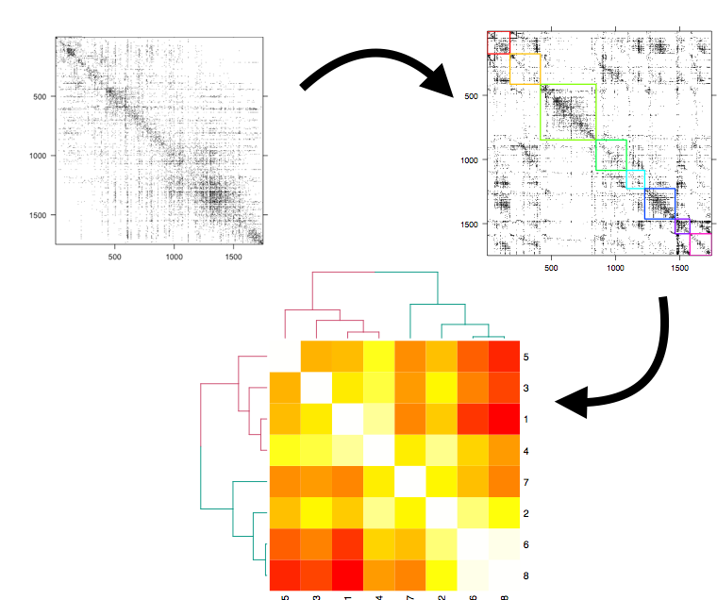
Drosophila Optic Medulla Connectome Code

Slide 57
References
Statistical inference on random dot product graphs: a survey
Law of Large Graphs for Statistical Connectomics
A Principled Approach to Human Connectome Estimation and Meganalysis
Community Detection and Classification in Hierarchical Stochastic Blockmodels

Slide 58

Questions?
Joshua T. Vogelstein, Dept BME, JHU
Co-founder: NeuroData Lab, Gigantum

Slide 59
